Slide 1

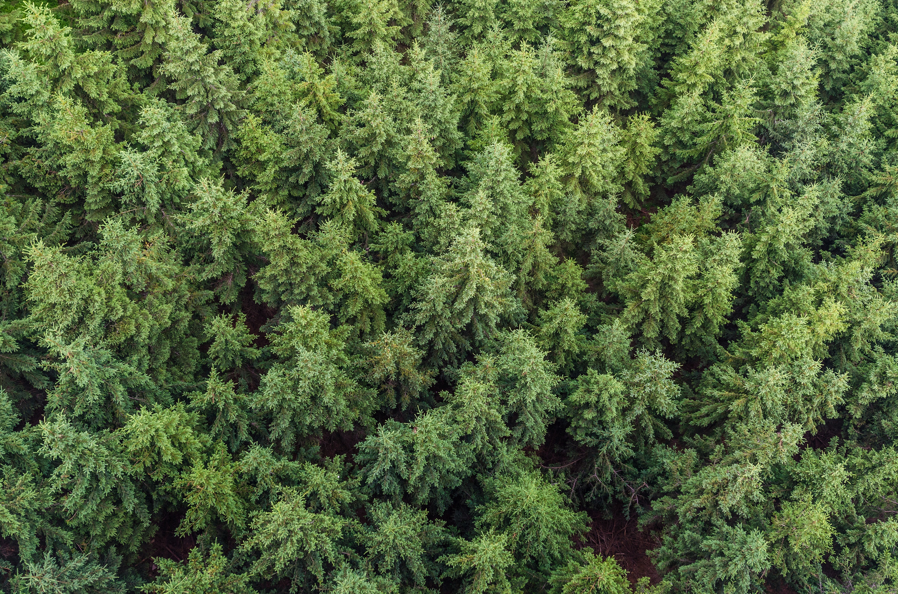




LAND-AI
taking care of home

Slide 2



650,000 KM
2
OF LAND ONCE SUITABLE FOR AGRICULTURE OR INTENSIVE GRAZING HAS BEEN LOST OVER THE LAST 50 YEARS.
https://www.worldwildlife.org/threats/deforestation-and-forest-degradation

Slide 3
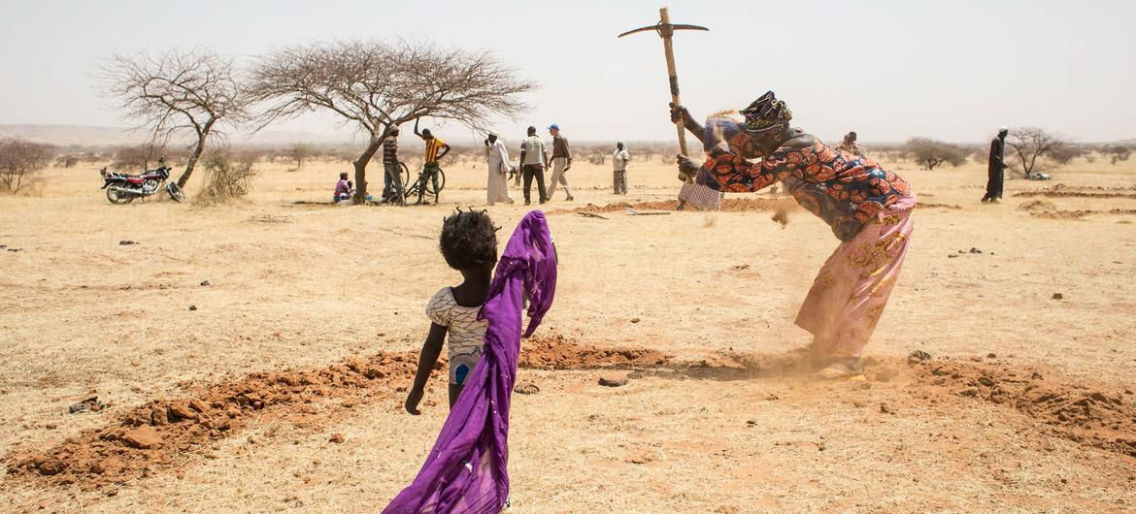
¿WHO IS MARIE?
“I’m a woman from Nigeria, i live near Sahel”
“I look up for water every 3 days during 1 hour”
“The degradation of sahel is problematic for vegetation”
“We dont have resurces due the farmers competition ”

Slide 4

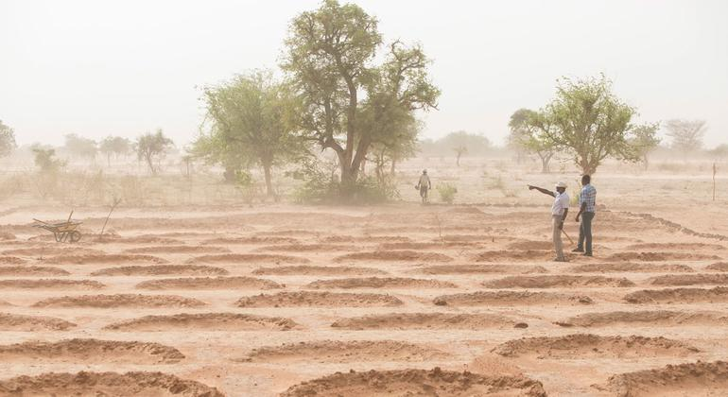
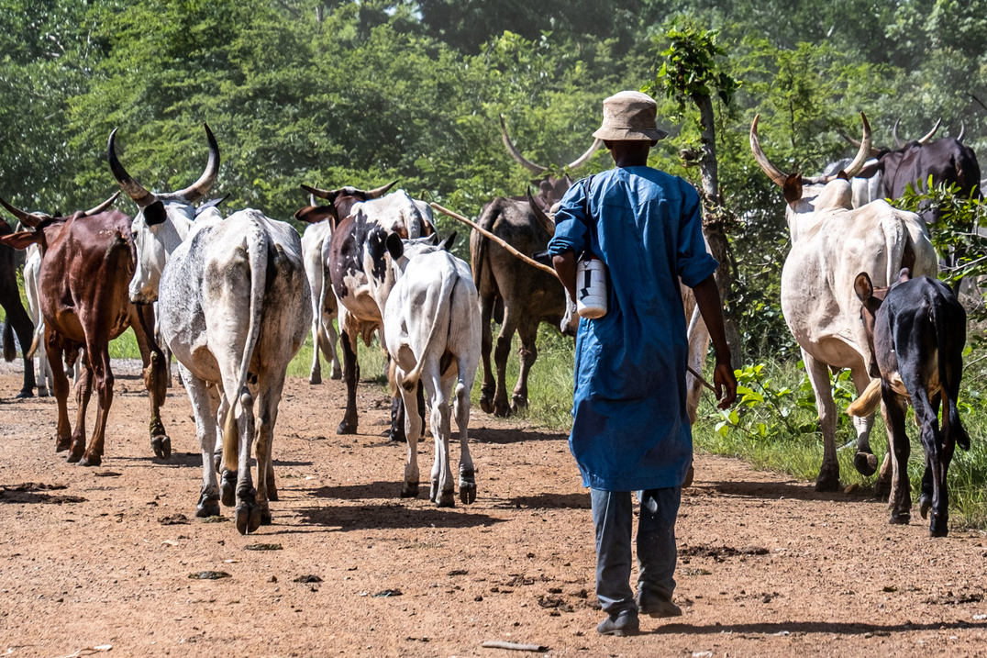
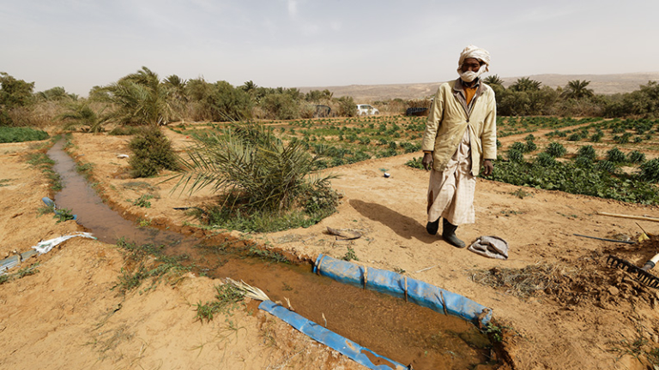
THE PROBLEM
LAND DEGRADATION
PASTORALISM
WATER PRECIPITATION

Slide 5

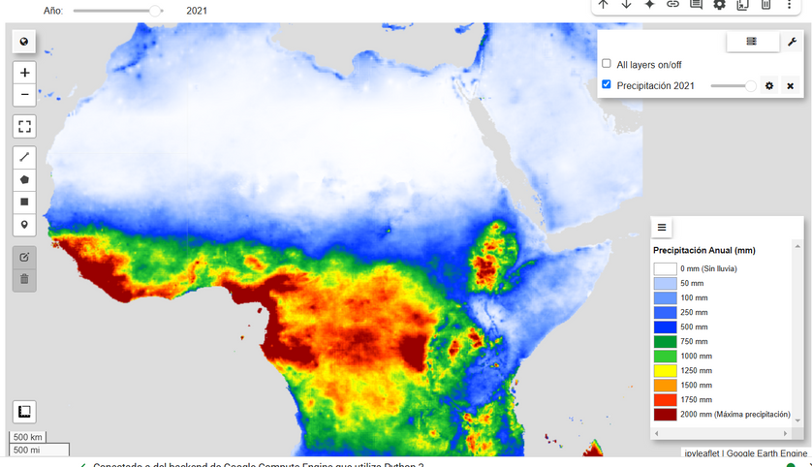
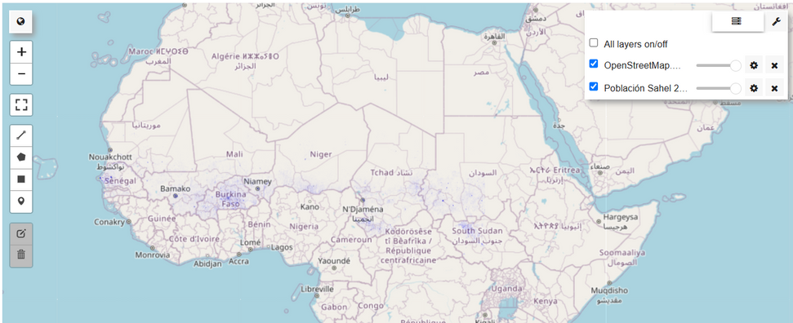
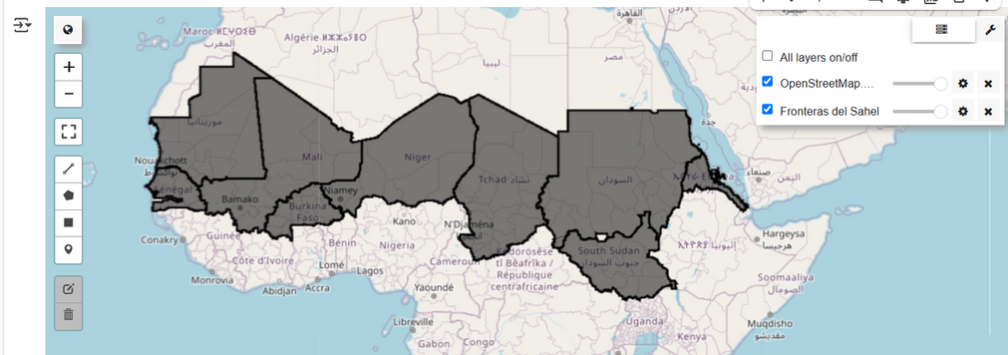
WHAT DO WE DO?

Slide 6
WHAT DO WE HAVE?
Precipicitation of water by time
Population
Territories

Slide 7

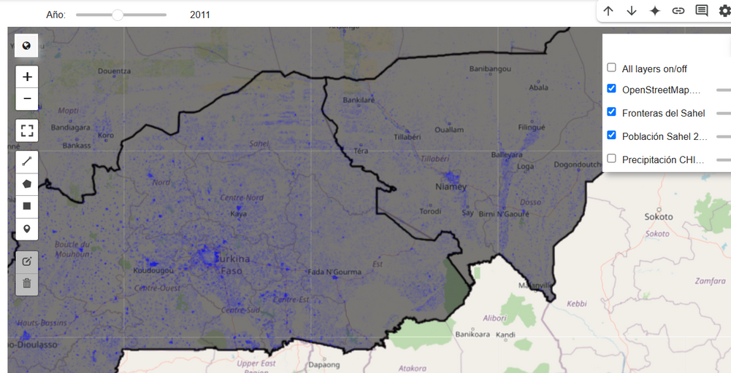
WHAT DO WE HAVE?
+
HOTSPOTS OF CHANGE IN VEGETATION & URBANIZATION
=

Slide 8
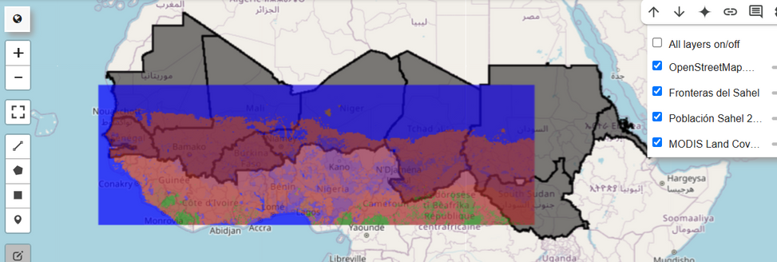
WHAT DO WE DO?
+
USING EO DATA FOR LAND & WATER CONFLICTS
=

Slide 9
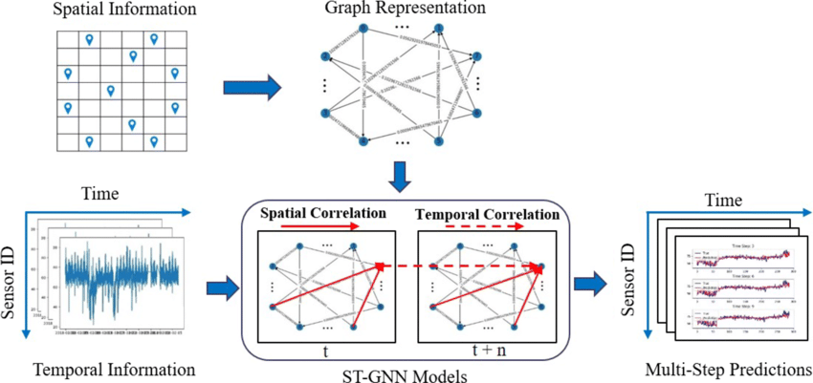
MODEL: STGNN

Slide 10
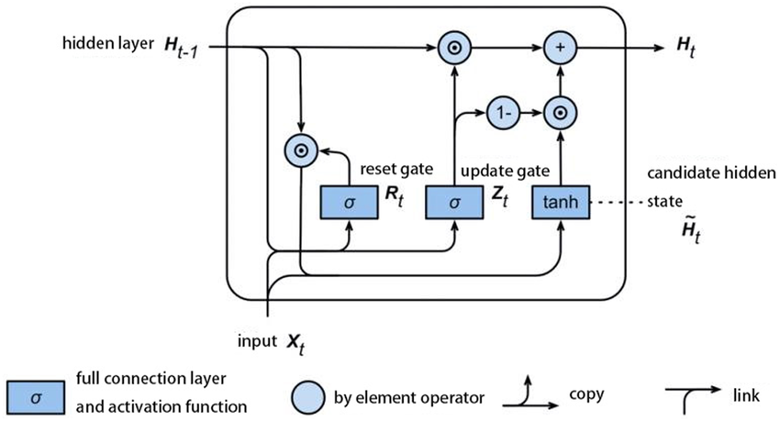
DEEP LEARNING

Slide 11
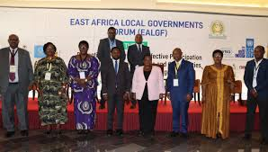






¿WHO WOULD USE IT?
Governant
conects with community leaders and inform about status of weather, vegetation, animal herding, population
community leader
community leader
community leader
community leader
community
community
community
community

Slide 12
¿DID WE ANSWER YOUR QUESTIONS?
KEY TRENDS AND LAND COVER CHANGES: OVER 20 YEARS WE IDENTIFY PATTERNS OF PRECIPITATION AND ALSO CATTLE THEFT
HOW HOTSPOTS OF VEGETATION AND URBAN EXPANSION : POPULATION IN EACH DISTRICT AND VEGETATION THROUGH THE YEARS
HOW CAN WE APPROACH THIS GLOBALLY:
INFORM COMMUNITY LEADERS AND GOVERNERS OF INDIGENOUS
GIVE RECOMMENDATIONS FOR WORLDWIDE FARMERS DURING ALL MONTHS.
HELP TAKING DECISIONS: FARMERS KNOW THE TIME OF YEAR FOR, POPULATION, VEGETATION, PRECIPITATIONS, ANIMAL HERDING SO THEY CAN PREVENT AND ALSO INFORM THEIR OWN COMMUNITY.

Slide 13
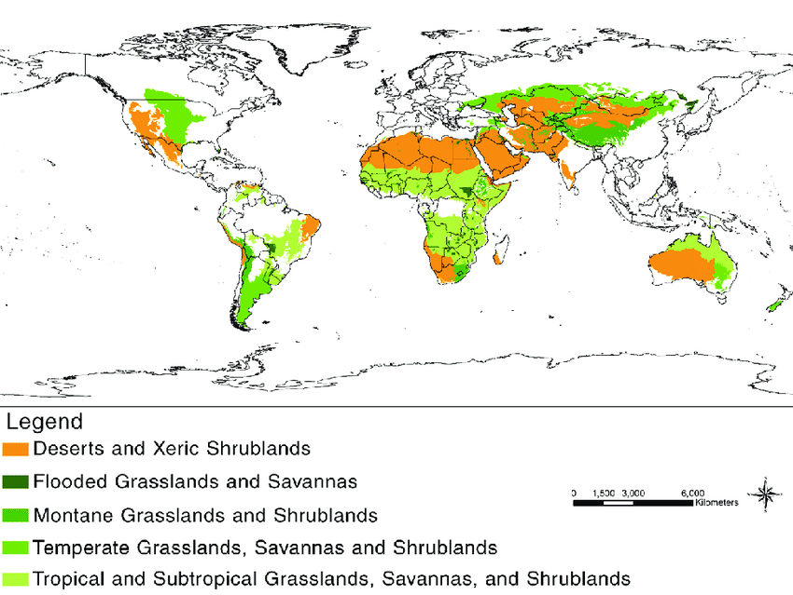
SAHEL IS THE BEGGINING
WE STILL NEED TO HELP THE ENTIRE WORLD

